Slide 1
Welcome

Slide 2
Recruiting the Right Leaders to Drive your Committee

Slide 3
St. Jude Evening Under the Stars Party & Golf Classic

Slide 4
St. Jude Evening Under the Stars Committees
Chairs: Valeria and Jeff Jones​
Led by Three Committees: Leadership, Sponsorship & Auction​
How to recruit quality committee members​
Committee goal: Revenue
Peer to peer led: current committee members recruit and vet new members​
Start with existing sponsors and donors​
Recruit the next generation: young adult children of current members​

Slide 5
Legends for Charity, Los Angeles (2022)

Slide 6
Legends for Charity, Los Angeles
Event Chair: Eric Shanks
Finding the right event chair
Identify and prioritize important qualities for your chair
Build your pipeline, start with St. Jude supporters in your market
Make it an easy “yes”
Committee recruitment pipeline
Harness your network
Tell your story
Setting expectations
Letter of agreement
Continuous relationship building
Building a committee doesn’t stop after the “yes”

Slide 7
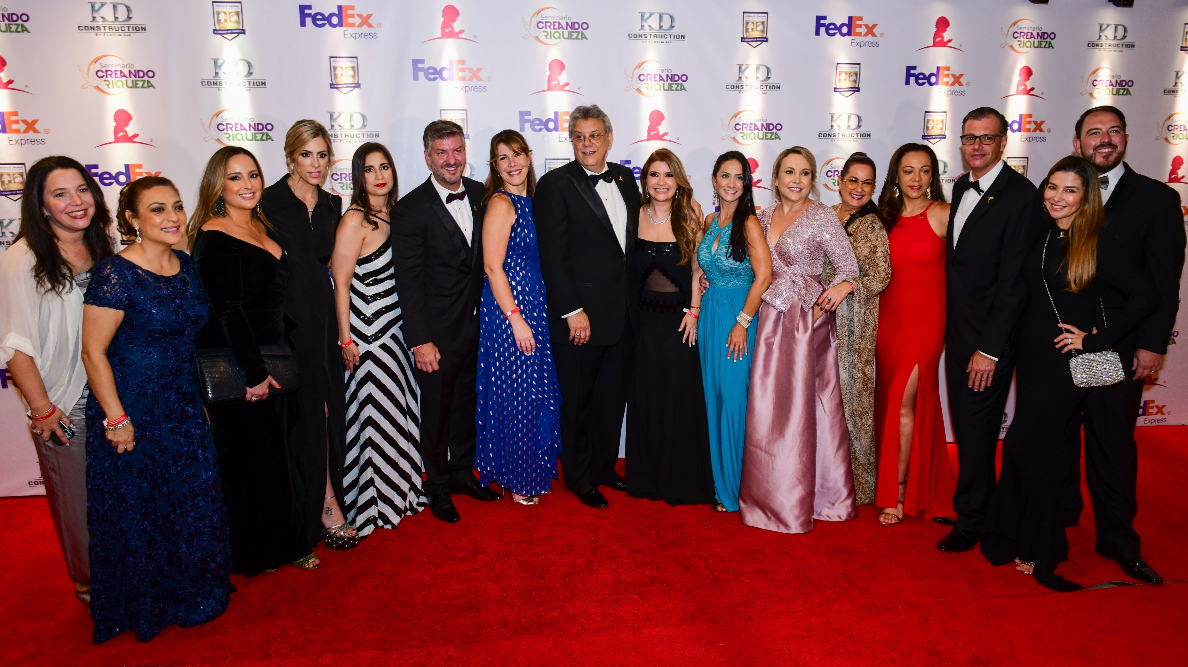
FedEx / St. Jude Angels & Stars
20th Anniversary Gala
May 20, 2022

Slide 8
FedEx / St. Jude Angels & Stars
Chair: Claudia Rostagno I Co-Founder: Julio Barrionuevo I 21 year committee members: 5 Circle of Hope Chair: Rosie Sotero Cruz
Evolution of chairmanship:
15 years (co-founders) to 2-year terms (vice chair & chair)
Expectations: Mentorship, Recruitment of vice chair is an ask of current chair
Committee structure:
Diversifying asks & skills: Executive, Steering, and Circle of Hope Committees
Creating an environment of success and impact. Recruiting for skill set.
Mechanisms to recruit:
Committee Mixers hosted by Chair
Kick Off event
In-person committee meetings
Intentional hosting at St. Jude activities both in market and including DGGLS
Notes:
Executive: Chair, Vice Chair, and specialized roles
Steering: Fundraising Drivers with $50,000 Give/Get
Circle of Hope: Tables/Tickets and Auction responsibility with $10,000 Give/Get

Slide 9
St. Jude Taste of Oxford Committee

Slide 10
St. Jude Taste of Oxford
Event Chair: Liz Randall
How do you keep your committee engaged?
Commitment to the mission and patient family involvement
Multiple patient families on committee
Largest charity event in Oxford with entire community engagement
Small and Mighty Committee
Variety of industry connections
High number of HVV committee members

Slide 11
Thank You

